Slide 1
The legal situation concerning EGTC
in Austria (Burgenland)

Slide 2
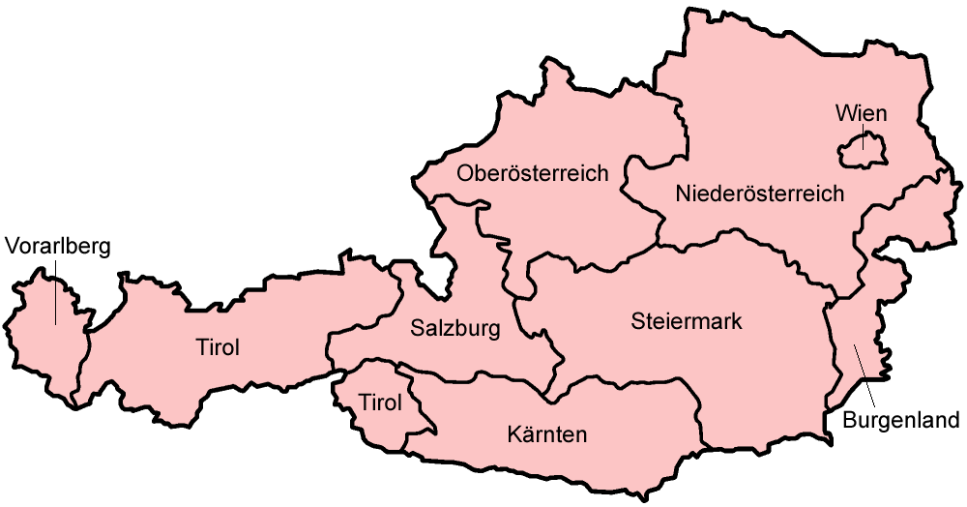

Slide 3
Regulation (EC) No 1082/2006 of the European Parliament and of the Council of 5 July 2006 on a European grouping of territorial cooperation (EGTC)
chance for the cooperation of regions in various fields
outstanding instrument for cross-boarder cooperation
possibility to establish cooperation groups with legal personality
encourages the economic and social cohesion of the EU

Slide 4
Article 2
Applicable law
1. An EGTC shall be governed by the following:
(a) this Regulation;
(b) where expressly authorised by this Regulation, the provisions of the convention and the statutes referred to in Articles 8 and 9;
(c) in the case of matters not, or only partly, regulated by this Regulation, the laws of the Member State where the EGTC has its registered office.
Where it is necessary under Community or international private law to establish the choice of law which governs an EGTC's acts, an EGTC shall be treated as an entity of the Member State where it has its registered office.
2. Where a Member State comprises several territorial entities which have their own rules of applicable law, the reference to the law applicable under paragraph 1(c) shall include the law of those entities, taking into account the constitutional structure of the Member State concerned.

Slide 5
Concretion of Regulation (EC) No 1082/2006 in following points necessary:
approval of the participation of Austria or an Austrian regional authority in an EGTC (Art. 4 Regulation (EC) No 1082/2006)
dissolation of an EGTC (Art 14 Regulation (EC) No 1082/2006)
registration and announcement of the statutes of an EGTC whose registred office is in Austria (Art 5 Regulation (EC) No 1082/2006)
control of an EGTC`s management of public funds concerning those EGTC`s whose registred office is in Austria (Art 6 and 9/2 lit g Regulation (EC) No 1082/2006)

Slide 6
Competence to substantiate the legal situation concerning EGTC
Art 10 – 15 B-VG (Austrian constitution)
Subjects listed – competence of the federal government
Sweeping clause that abets the regional authorities
competence of the federal government?
competence of the regional authorities?
↓
9 + 1 scheme (9 coincident regional laws + 1 coincident federal law

Slide 7
The legal situation concerning EGTC in Burgenland
Gesetz vom 24. Feber 2011 über die Anwendung der Verordnung des Europäischen Parlaments und des Rates über den Europäischen Verbund für territoriale Zusammenarbeit (Burgenländisches EVTZ-Gesetz – Bgld. EVTZG)
= the Bgld. law concerning the application of Regulation (EC) No 1082/2006
came into force in April 2011
short and firm law
6 articles

Slide 8
Bgld. EVTZG - Bgld. law concerning the application of Regulation (EC) No 1082/2006
§ 1 – area of application of the law
§ 2 – approval and interdiction
§ 3 – registration of an EGTC
§ 4 – dissolation of an EGTC
§ 5 – control of management of public funds
§ 6 – legal validity

Slide 9
Thank you for your attention!

