Slide 1
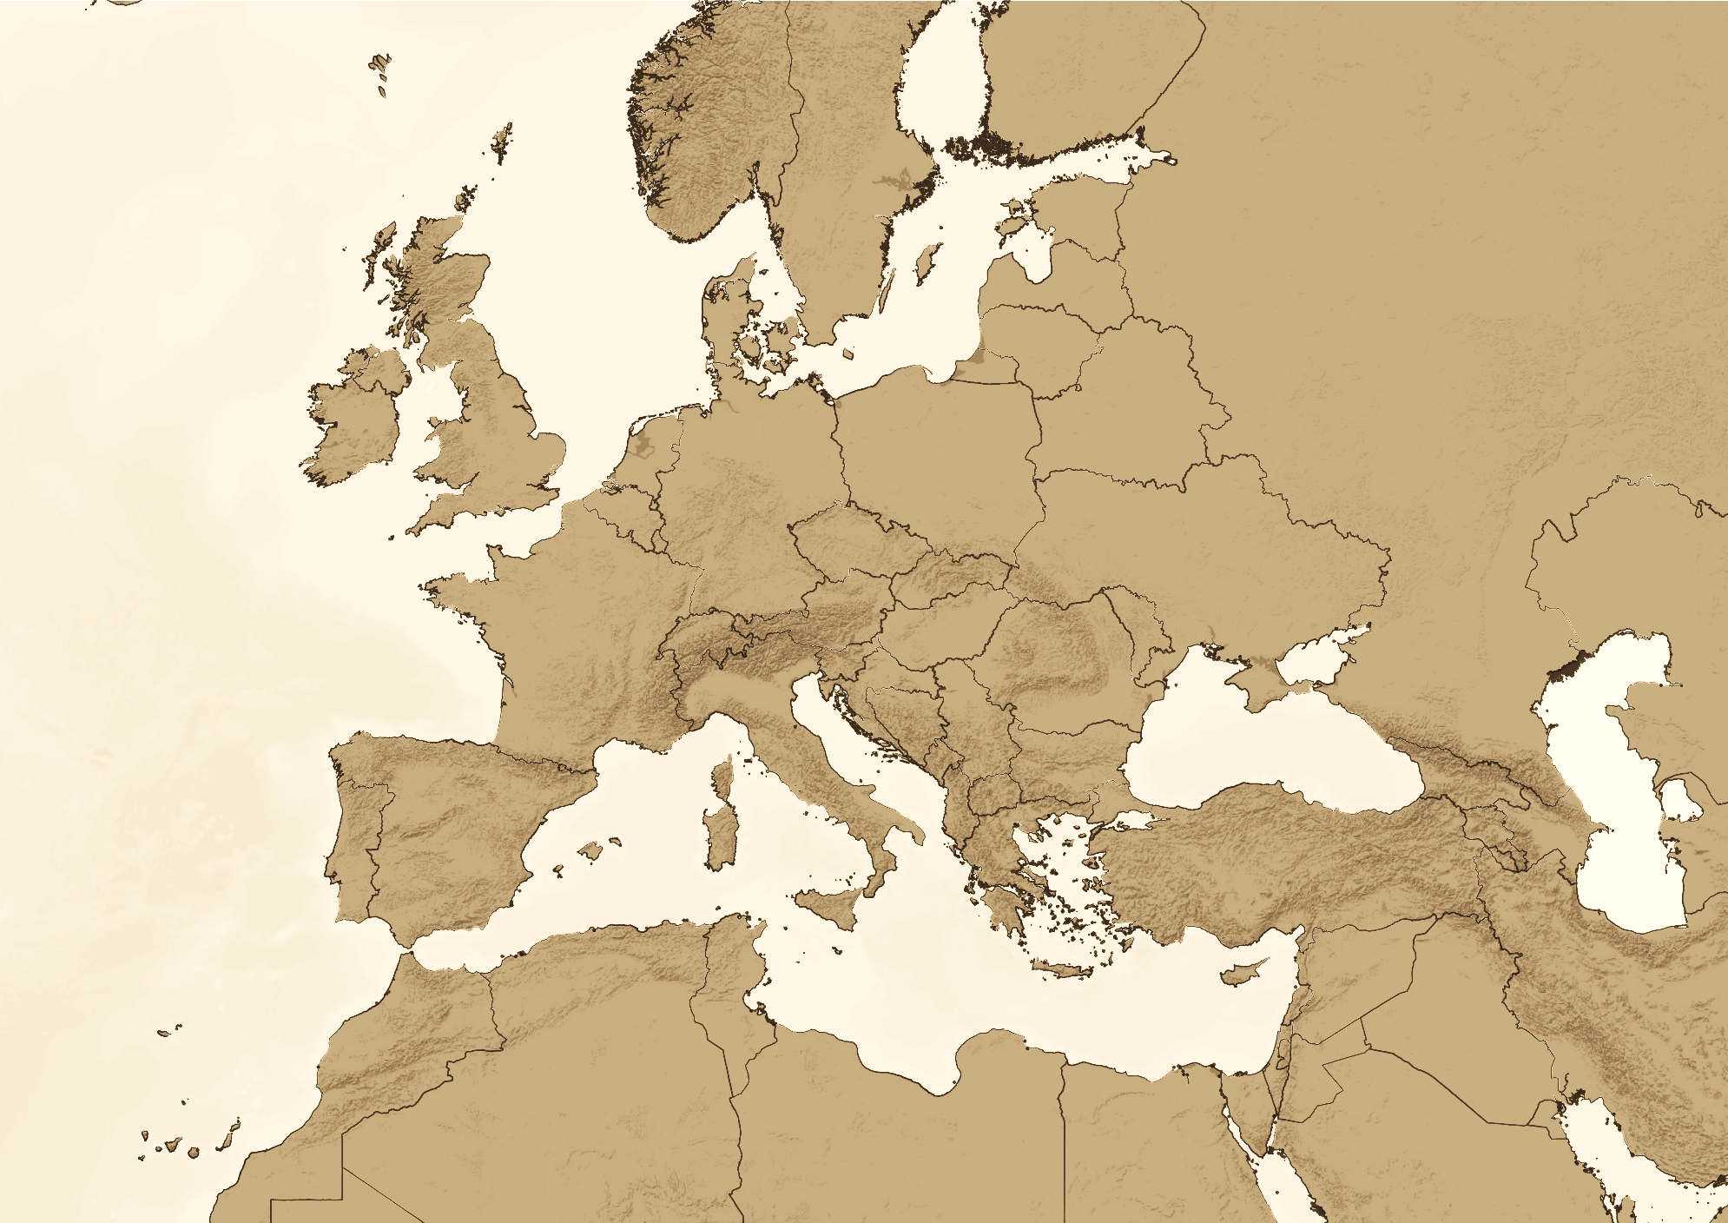
Legal accessibility
Gyula Ocskay
secretary general

Slide 2
http://legalaccess.cesci-net.eu
Legal accessibility 2.0 (2017)
Cross-border movement of ambulance cars
Cross-border trade of local products
EGTC law for Serbia
Integration of information facilitating border-crossing life
Legal accessibility 3.0 (2018)
Cross-border movement of ambulance cars – with the neighbours
Cross-border health care service provision
Study on daily experiences of EGTCs (new Cohesion Policy package)
Legal accessibility V4 (2018-2019)
3 level legal accessibility mechanism: interministerial working group, bilateral joint committees, V4 platform

Slide 3
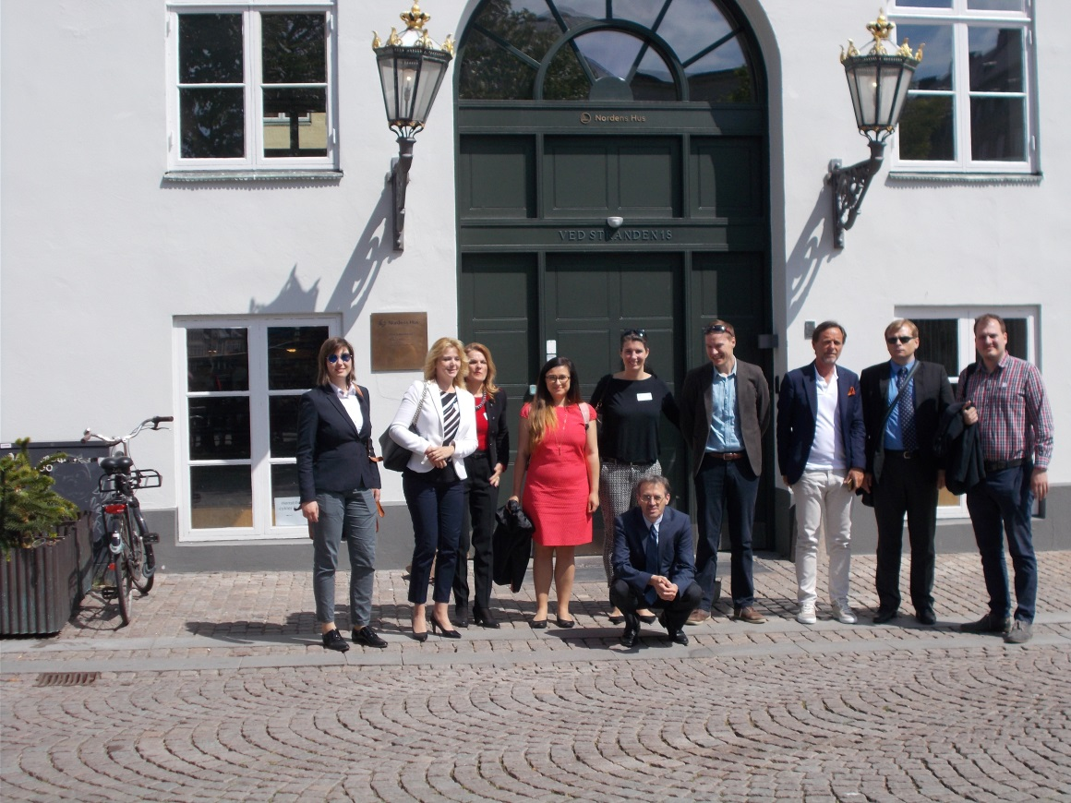
ACTIVITIES OF THE V4 PROJECT
Kick off conference
Study tour to Copenhagen
Study on the Nordic Model
Study on the adaptation of the Nordic Model
Handbook of V4 Mobility Council
Closing conference

Slide 4
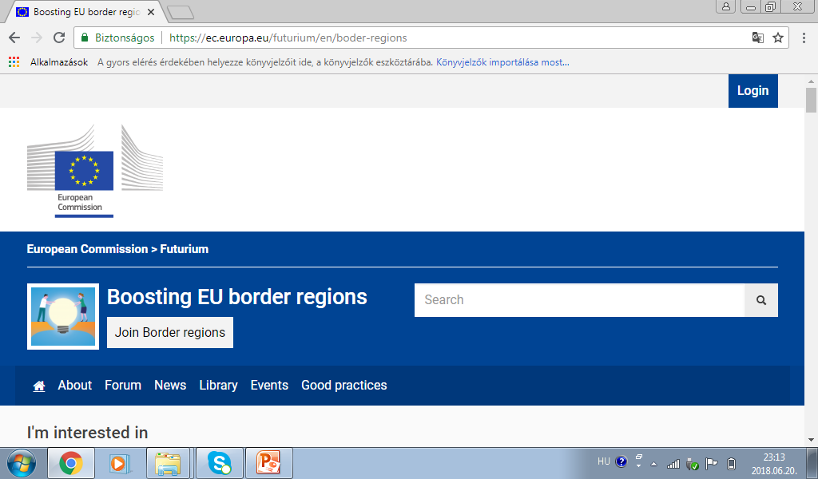
EU LEVEL DEVELOPMENTS
New draft Regulation on European Cross-Border Commitment and European Cross-border Statement
The work of the ECBC Working Group is continuing
The Border Focal Point has started its operation
The Boosting Platform has started its operation

Slide 5
THANK YOU FOR YOUR KIND ATTENTION!
Gyula Ocskay
gyula.ocskay@cesci-net.eu
http://legalaccess.cesci-net.eu
The project is co-financed by the Governments of Czechia, Hungary, Poland and Slovakia through Visegrad Grants from International Visegrad Fund. The mission of the fund is to advance ideas for sustainable regional cooperation in Central Europe.

