Slide 1
Implementation of the amended EGTC regulation in FRANCE
Budapest – 16th & 17th April 2015

Slide 2
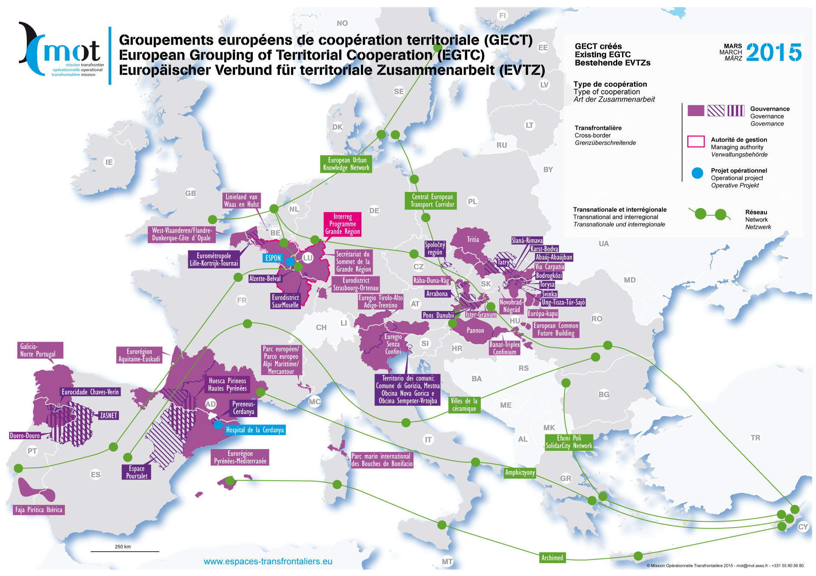

Slide 3
I. Composition of an EGTC
EU Legal Framework
Amended EGTC Regulation (EC) 1082/2006, article 3.1:
The following entities may become members of an EGTC:
(a) Member States or authorities at national level;
(b) regional authorities;
(c) local authorities;
(d) public undertakings within the meaning of point (b) of Article 2(1) of Directive 2004/17/EC of the European Parliament and of the Council or bodies governed by public law within the meaning of the second subparagraph of Article 1(9) of Directive 2004/18/EC of the European Parliament and of the Council ;
(e) undertakings entrusted with operations of services of general economic interest in compliance with applicable Union and national law;
(f) national, regional or local authorities, or bodies or public undertakings, equivalent to those referred to under point (d), from third countries, subject to the conditions laid down in Article 3a.
Associations consisting of bodies belonging to one or more of
these categories may also be members.
French Legal Framework
Transposition of EGTC regulation 1082/2006 in French Law by the law n° 2008-352, 16 April 2008
(Article L. 1115-4-2 of the Code général des collectivités territoriales )
“Local authorities and their associations, bodies governed by public law within the meaning of the second subparagraph of Article 1(9) of Directive 2004/18/EC of the European Parliament and of the Council of 31 March 2004 on the coordination of procedures for the award of public works contracts, public supply contracts and public service contracts “may become members of an EGTC.
For all the matters that have not been specified in the EU regulation or in the convention creating the EGTC, French Law EGTC are submitted to rules related to the Syndicat mixte ouvert, providing them legal and financial security.

Slide 4
Challenges dealing with the composition of an EGTC
French law has not been adapted to the amended 2013 EGTC regulation. Therefore, it does not authorize the following entities to be part of an EGTC :
  Authorities at national level (including Private law Authorities)
  Public undertakings of Annex III of Directive 2004/17/EC (private law) and undertakings entrusted with operations of services of general economic interest.
  Article L. 1115-4-2 CGCT refers to the possibility of creating an EGTC with “EU MS and border MS of the Council of Europe”. It does not refer to local authorities from third countries states and third countries states.

Slide 5
  Challenges dealing with the composition of an EGTC
  Even though French Law does not refer to all of the EGTC potential members, EU regulation direct effect provides solutions in most cases :
  France is a member of GECT INTERREG IV, which is presided over by the Préfet de Lorraine, although French Law does not explicitly allow a State to be a member of an EGTC.
  An EGCT may be created between Saint-Martin and Sint Maarten (Antilles), even though French law does not yet explicitly allow cooperation between overseas countries.

Slide 6
II. Legal Basis for State Approval for EGTC
EU Legal Framework
Amended EGTC Regulation (EC) 1082/2006, article 4.3 :
  Reasons for non-approval of the convention include in particular national law relating to the powers and competences of the prospective member
  Nevertheless article 7.2. states :
  « Each task (of an EGTC) shall be determined by its members as falling within the competence of every member unless the Member State or third country approves the participation of a member established under its national law even where that member is not competent for all the tasks specified in the convention »
French Legal Framework
In relation with the concerned Préfet de région who authorizes the creation or the participation of local authority to an EGTC, the Ministry of the Interior focuses on :
the competence of every member under French Law.
Consistency at national level and with France’s international commitments (art L. 1115-4-2 CGCT), which implies to consult French Ministry of Foreign Affairs.
For these reasons, France would not approve the participation of a French local Authority to an EGTC if it is not competent for the tasks specified in the convention.

Slide 7
Legal Basis for State Authorization
EU Legal Framework
Amended EGTC Regulation (EC) 1082/2006, article 4.3 :
Reasons for non-approval have to be exposed to the potential members
Decision of approbation within a period of six months from the date of receipt of a notification and tacit approbation if no objection within that period
Formal approbation by the MS where the proposed registered office of EGTC is to be located
French Legal Framework
French law already requires the State to communicate the reasons of a refusal. The absence of notification of those reasons can lead to the cancellation of the decision by an administrative court.
Explicit authorization prior to joining the EGTC is still required in French law, even if the EGTC is to be based in another country (art. L. 1115-4-2 CGCT) :
In any case, French authorities are informed of the territorial cooperation projects. Therefore, the new Regulation should not create big difficulties.

Slide 8
CONTACT DETAILS
Martin LESAGE
  Ministère de l’intérieur
  Direction générale des collectivités locales (DGCL)
  Sous-direction de compétences et institutions locales
  Chef du bureau des structures territoriales
  martin.lesage@interieur.gouv.fr
Info on local authorities in France : http://www.dgcl.interieur.gouv.fr/

