Slide 1
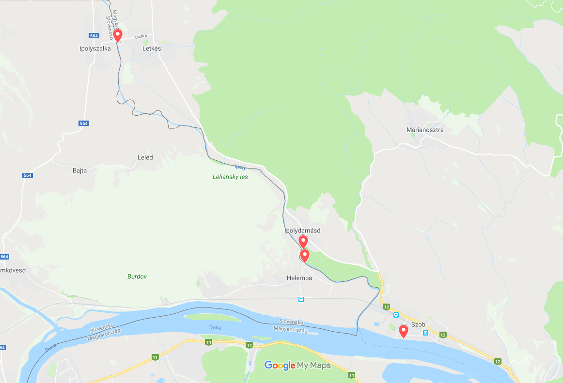
Aim of the project
The project aims at establishing kayak-canoe piers (floating platforms) on the river Ipoly in order to develop water tourism and to offer sporting opportunities for residents on both sides of the border.
Helyszín | Megvalósulás helye
Letkés | Ipoly 12+470 FKM bal parti szelvény
Ipolydamásd | Ipoly 3+900 FKM bal parti szelvény
Helemba | Ipoly 3+515 FKM jobb parti szelvény
Szob | Duna 1706+980 FKM bal parti szelvény

Slide 2
Authorization process on the Hungarian side | Experiences
Consent of trustees | Problems related to state ownerships and rights of trustees may hinder the procedure.
Authorization of establishment (Budapest Metropolitan Government Office) | Single-window system is an asset, the responsible authority contacts all the specialized authorities, this way decreasing the administrative burden of the applicant.
Hungarian-Slovak Cross-Border Waters Committee | Asking for standpoint – problem: it is not stipulated in national legislation, but is binding based on an international agreement.
(Lease) contract on water use | It can be requested from the trustee of the given water (KDVVIZIG) in the possession of the authorization, the procedure is fast.
Certificate of occupancy | The procedure is fast, according to the related act (on general public administration procedures), the conditional decision binds the authority as well. An on-site inspection is carried out by the authority before issuing the certificate.

Slide 3
Authorization process on the Slovak side | Experiences
Slovak Watermanagement Enterprise (Slovenský vodohospodársky podnik) | Preliminary standpoint – the procedure is fast.
Environment management unit of the Office of Nitra District (Okresný úrad Nitra) | Authorization – the procedure is fast, but installation depends on the decision of the Transport Authority due to the significant capability of the floating platforms.
Slovak Watermanagement Enterprise (Slovenský vodohospodársky podnik) | Authorization
Transport Authority (Dopravný úrad) | Issuing the authorization necessitates the involvement of many other authorities. The lack of single-window system causes difficulties.
Issuing the certificate | The floating platform is a European standard, still, further certificates are needed. Installation works can be realized as a second step, after the on-site inspection of the Transport Authority.
Preliminary standpoints of specialized authoritites and interim commenting procedures | Standpoint of the National Nature Protection Autohrity of the Slovak Republic (NATURA 2000 area), and standpoint of the Nature protection unit of the Office of Nitra District.
 | Consent of the Slovak Land Bureau (prolonged procedure)
In the possession of a registration number, after issuing the certificate | Consent of the Environment management unit of the Nové Zámky District regarding the installation and operation.
 | Repeated consent of the Slovak Watermanagement Enterprise – in which the registration number issued by the Transport Authority is indicated.
 | Concluding a property insurence regarding the floating platform.
Hungarian-Slovak Cross-Border Waters Committee | Asking for standpoint is amongst the criteria defined by the authorities.

Slide 4
