Slide 1
Future ETC (Interreg), EGTC and ECBM Meeting of EGTC approval authorities Budapest (HU) 28 October 2019 Dirk Peters
Cohesion Policy post-2020

Slide 2
The Cross-border multistage or step rocket
A multistage rocket, or step rocket is a launch vehicle that uses two or more rocket stages, each of which contains its own engines and propellant.
Stage 1: INTERREG (joint strategy and money)
Stage 2: EGTC (common structure and mutual trust)
Stage 3: ECBM (legal obstacles and initiators)

Slide 3
ETC (Interreg)
Cohesion Policy post-2020

Slide 4
Key legal instruments
ERDF/CF Regulation
Cohesion policy priorities are here (e.g. specific objectives and thematic concentration requirements)
Specific objectives
New interregional innovation investments
(ESF+ Regulation)
Common Provisions Regulation (CPR)
Delivery elements are here
ETC (Interreg) Regulation
EGTC Regulation
No amendments proposed
ECBM Regulation
Only if cross-border projects!

Slide 5
Shorter & modern menu of priorities 5 Policy objectives + 2 Interreg-specific objectives
A smarter Europe (innovative & smart economic transformation)
A greener, low-carbon Europe (including energy transition, the circular economy, climate adaptation and risk management)
A more connected Europe (mobility and ICT connectivity)
A more social Europe (the European Pillar of Social Rights)
A Europe closer to citizens (sustainable development of urban, rural and coastal areas and local initiatives)
---
1. A better cooperation governance [address border obstacles!]
A safer and more secure Europe
Thematic concentration!

Slide 6
European grouping of territorial cooperation
Cohesion Policy post-2020

Slide 7
The different roles of EGTCs
What can an EGTC do under the EGTC-Regulation?
What can an EGTC do under the ETC-Regulation?
What can an EGTC do under the IGJ goal?
What can an EGTC do under other EU programmes?

Slide 8
EGTC Regulation: Article 7(2) and (3)
“facilitation and promotion of territorial cooperation” (2)
“may carry out specific actions of territorial cooperation”
with financial support from the Union or
without financial support from the Union (3) 1st sub§
“Specifically, tasks may concern the
implementation of cooperation programmes (EGTC signs grant letters as managing authority)
or parts thereof or of
operations supported by the Union through the ERDF, ESF and/or CF (3) 2nd sub§

Slide 9
European grouping of territorial cooperation
CPR: point 27 of Article 2 – always public expenditure
ERDF: °/°
ETC (Interreg)
Article 20: Integrated Territorial Investment (ITI)
Article 23(6): Sole beneficiary of Interreg projects
Article 24(2): Small Project Fund (SPF) beneficiary
Article 28(1): Composition MC (“may”)
Article 44(4): MA
[CPR/ERDF: integrated interregional cooperation under the IJG goal]

Slide 10
Integrated territorial development and investment
Article 23 CPR Territorial strategies
under the responsibility of the relevant urban, local or other territorial authorities or bodies
Selected operations shall comply with the territorial strategy
tasks falling under the responsibility of the managing authority other than the selection of operations → authority identified by the managing authority as an intermediate body
Article 24(1) CPR Integrated territorial investment (PO5)
Where a strategy implemented in accordance with Article 23 involves investments that receive support from
one or more Funds,
from more than one programme or
from more than one priority of the same programme,
actions may be carried out as an integrated territorial investment ('ITI').

Slide 11
New: Small project funds (Article 24) (PO5 or ISO1)
Only for Interreg
SPF = "operation“ [small projects ≠ people-to-people projects]
EUR 20 million or 15% per SPF under an Interreg programme
"Final recipients" implement "small projects" (§1)
Cross-border legal body or EGTC = beneficiary (§2) Legislators: less strict
Content of grant letter (§3)
Selection of small projects ≠ delegation of tasks to an IB (§4)
20% max. for staff and management costs (§5)
Small project < EUR 100.000 → SCO obligatory (§6)

Slide 12
Improvements outside EGTC/ETC Regulations
CPR
point 27 of Article 2: EGTC expenditure is always public
ECBM
"Initiator"
Outside Cohesion Policy
Public Procurement Directives
Beneficiary Horizon2020, Life+, Erasmus, CEF, Europe for Citizens etc. (DG REGIO letter to all COM services)
Financial Regulation: Sole beneficiary

Slide 13
ECBM
Cohesion Policy post-2020

Slide 14
Why is it needed?
Article 174 of TFEU: "particular attention to …cross-border…regions"
In spite of the Single Market legal and administrative obstacles still hamper cross-border interactions in the EU.
"If only 20% of existing obstacles were removed border regions would still gain 2% in GDP."
(Com(2017)534, data from Politecnico de Milano)

Slide 15
What is it?
A legal mechanism to overcome legal obstacles that hamper stronger cross-border interaction
A framework to establish case by case agreements to overcome existing obstacles in two forms
Within those limits, allows for the application in one MS of the legal provisions from another MS

Slide 16
What it is not?
A revision of, or a new form of EGTC
A mere support for INTERREG
A way to bypass national legislative powers
An European cross-border statements (ECBS) concerns mainly non-legislative obstacles, but also legislative if the MSt so wishes
When a European cross-border commitments (ECBC) is agreed, it only commits authorities to present proposals to the respective legislative body

Slide 17
European Cross-border mechanism
Voluntary instrument, but effective system on each border obligatory! (4)
Cross-border Coordination Points at national/regional level (5+6)
Commission Border Focal Point (7)
Step 1 – Preparation and submission of initiative document (8+9)
Step 2A – Preliminary analysis by committing and transferring MSt (10+11)
Step 2B – Follow-up (12)
Step 3 – Preparation and conclusion/signature of ECBC/ECBS (13-17)
Step 4 – Implementation (18+19)
Step 5 – Monitoring (20)
Legal protection (21+22)
Final provisions (23-26)

Slide 18
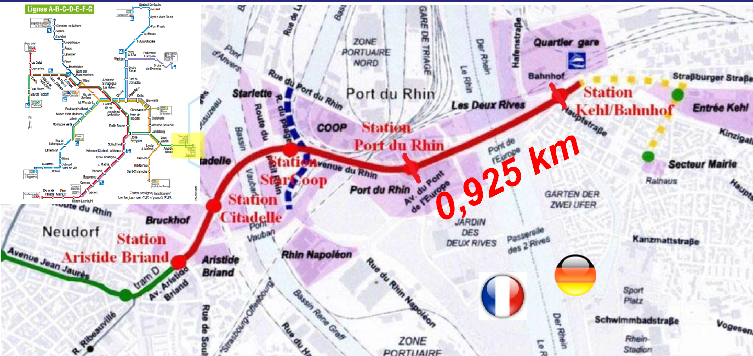
Extension of tramway line Straßburg (FR) - Kehl (DE)

Slide 19
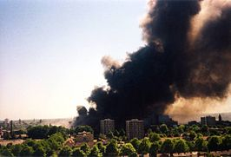
Obstacles in emergency services
Firefighters and ambulances are in many cases prevented to intervene as legal restrictions impede them from crossing the border
13/5/2000
Major explosion in firework factory in Enschede (NL) on DE border;
Police cars were already allowed to cross the border with their signals, but not the ambulances! An on-the-spot solution had to be found: one police car with the siren on ran in front of an (silent) ambulance which followed at the same speed.
Solved for DE-NL: 2004.
Solved for NL→ DE/BE: 2009!

Slide 20
... just some examples under b-solutions
Health:
EGTC-Hospital de Cerdanya (ES-FR): absence of a standardized method of mutual recognition of qualifications prevents the creation of stable cross-border teams
Institutional cooperation:
EGTC Arrabona Ltd (HU-SK): renting across the border of machines used for different purposes (e.g. to cut down larger trees, to shift snow, baling, etc.)
EGTC Eurodistrict SaarMoselle (FR-DE): joint establishment and use of facilities for shared cross-border public services of crèches
Public transport:
EGTC Eurodistrict Strasbourg-Ortenau (FR-DE): European solution for a vignette for air pollution control

Slide 21
First level (single decision per border – Article 4)
Member States identify Cross-border contact point
Member States decide, per border, whether to use the ECBM or an existing mechanism
Co-legislators?
Council? Opinion of its Legal Service
European Parliament Draft report on ECBM: case-by-case, not per border Draft report on CB Healthcare Directive: 13. "Encourages the MSt and border regions…" 14. "Welcomes the COM's proposal..."

Slide 22
Second level (one decision per obstacle Artt. 8-20)
Initiator (Art.8) identifies legal obstacle
No or unclear
Initiator sends "initiative document" to CBCP (at national level) (Art. 9)
Is there a legal obstacle?
CBCP makes preliminary analysis (Art. 10)
Yes
ECBC or ECBS?
Implement Monitor and Inform
ECBC (Art. 18) => Self-sustained (extraterritoriality of legal frame)
ECBS (Art. 19) => Proposal for legislative revision (national legislative body to decide)

Slide 23
Many thanks for your attention! Dirk.Peters@ec.europa.eu
Cohesion Policy post-2020

